Slide 1
Detection of small and far Traffic signs using Deep Learning

Slide 2
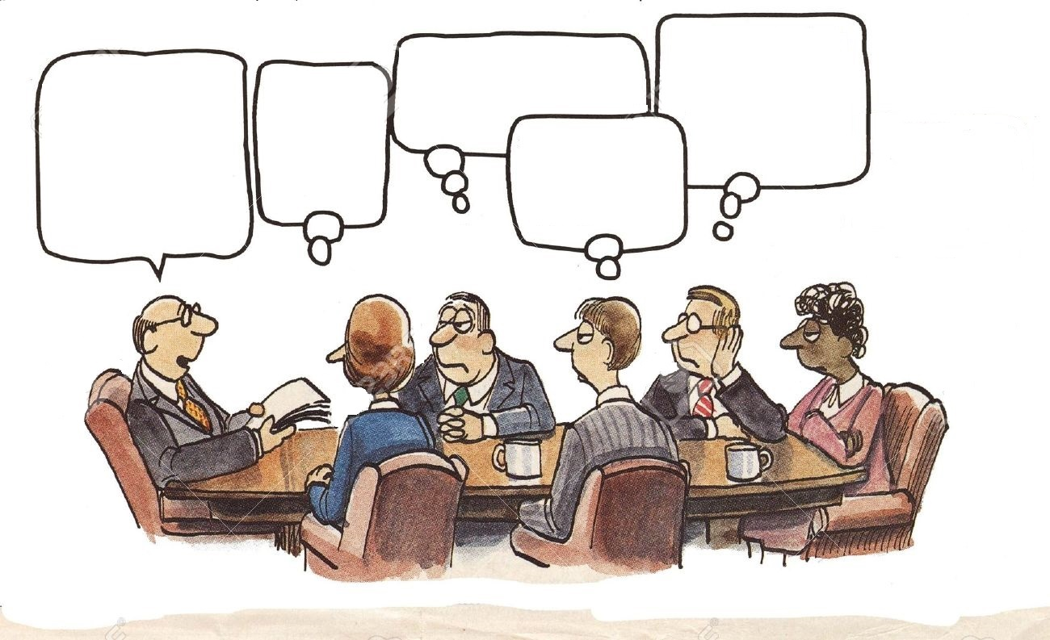
AGENDA
Model Selection &
Dataset
What is our Agenda?
Conclusion
Problem
Statement
Evaluation
Metrics

Slide 3
Problem Statement

Slide 4

Why do we need to detect small and far traffic signs?
Solution
Deep learning models capable of effectively detecting and recognizing these signs across a wide range of sizes. They must be robust against environmental variations, employing techniques like domain adaptation, adversarial training, or data augmentation with simulated environmental effects.
GAP/challenges
Increased visibility, early identification and response, improved decision-making, and the support of advanced driver assistance systems. Computer vision techniques were used to detect and categorize traffic signs, but this approach involved extensive manual effort to carefully design significant features within images.
Problem
According to the Bureau of Labor Statistics, a car accident occurs approximately every 13 minutes in the U.S. Traffic signs play a crucial role in regulating traffic flow, providing important warnings, and conveying vital information. The ability to detect traffic signs from a significant distance plays a vital role in addressing the issue of non-compliance with traffic rules and signs.
Notes:
What is the current state of the problem and how do we reach the Future state filling the gap in between.

Slide 5
Literature review

Slide 6

What is the best model for the current research problem?
Based on the literature review, there are certain pros and cons listed down for each of model that help us in choosing the best model for out problem statement.
R-CNN
Fast R-CNN
Which way to Chose?
Faster R-CNN
YOLO

Slide 7
Summary
S.no | Method | mAP (%) | Speed (FPS)
1 | R-CNN | 66 | 0.05
2 | Fast R-CNN | 69.9 | 0.5
3 | Faster R-CNN | 73.2 | 7
4 | YOLO | 63.4 | 45
5 | YOLOv5s | 77 | 97.08
6 | Faster RCNN + FPN | 78.6 | -
7 | YOLOv6 | 81.3 | 19.92
8 | YOLOv7 | 57.1 | 26.73
9 | STC-YOLO | 88.9 | 87.71
10 | M-YOLOv5 | Coming soon! | Coming soon!

Slide 8
Model and Dataset

Slide 9
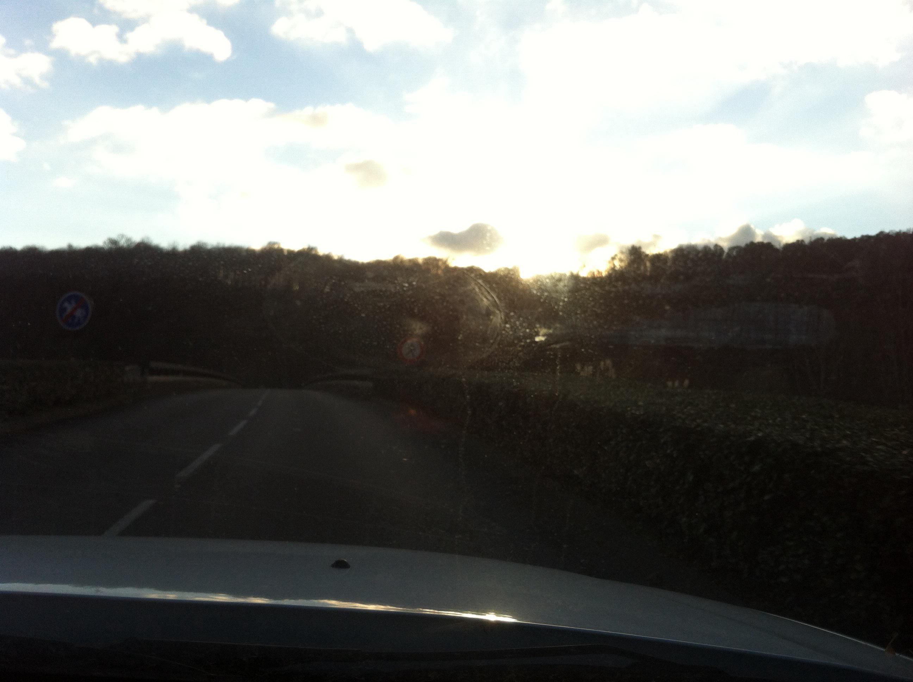
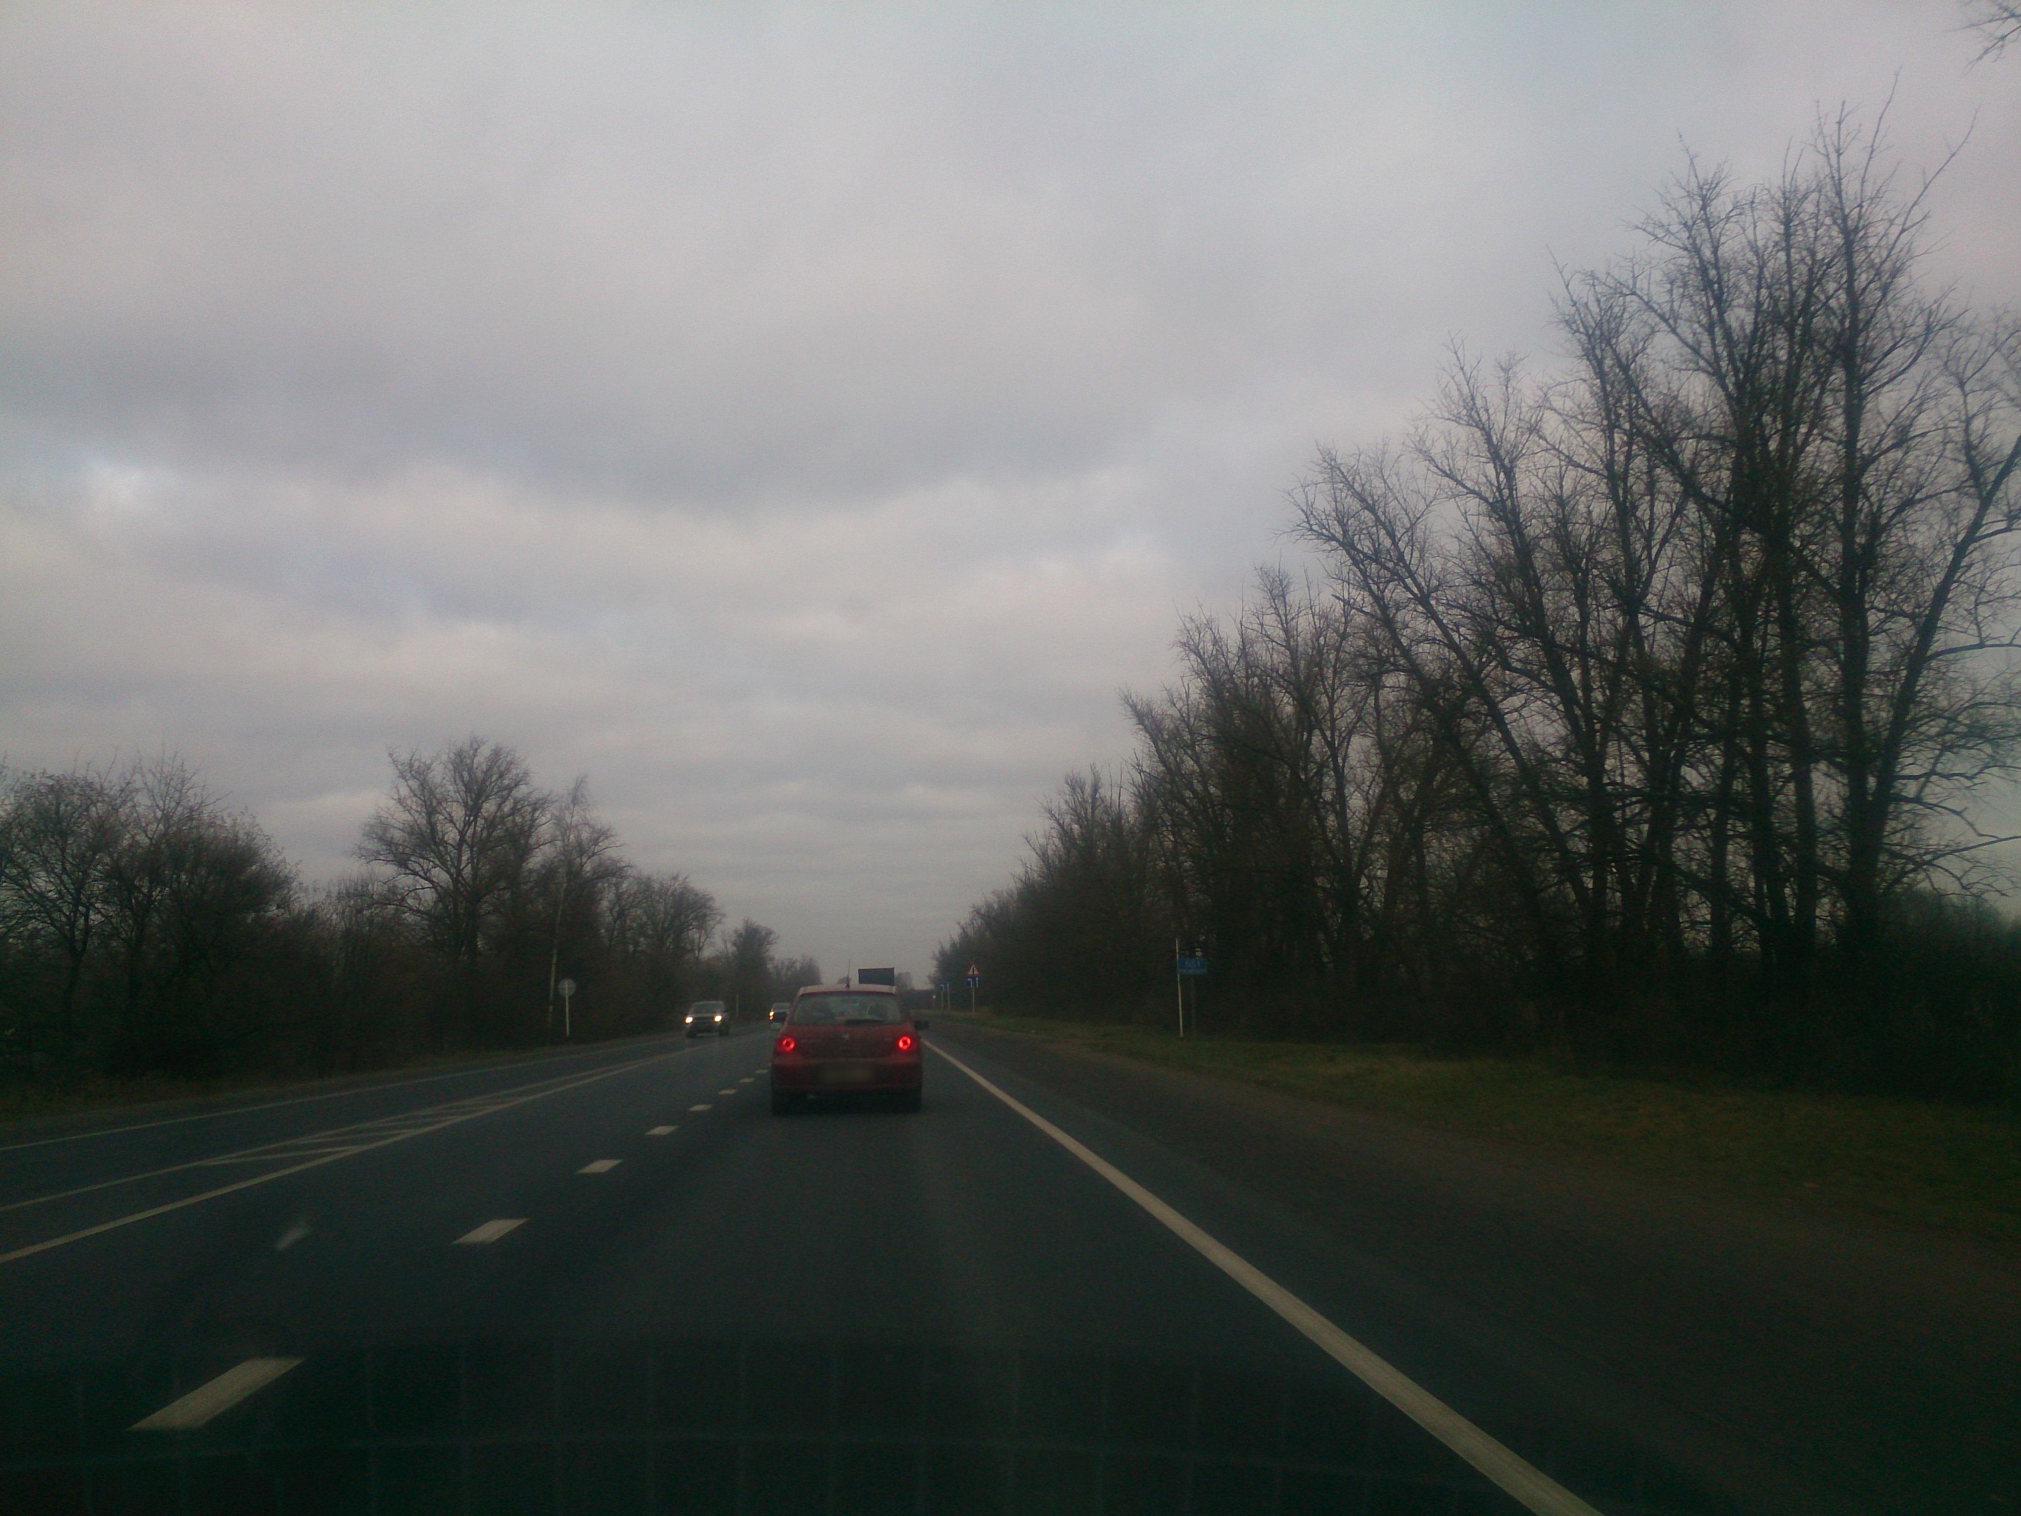
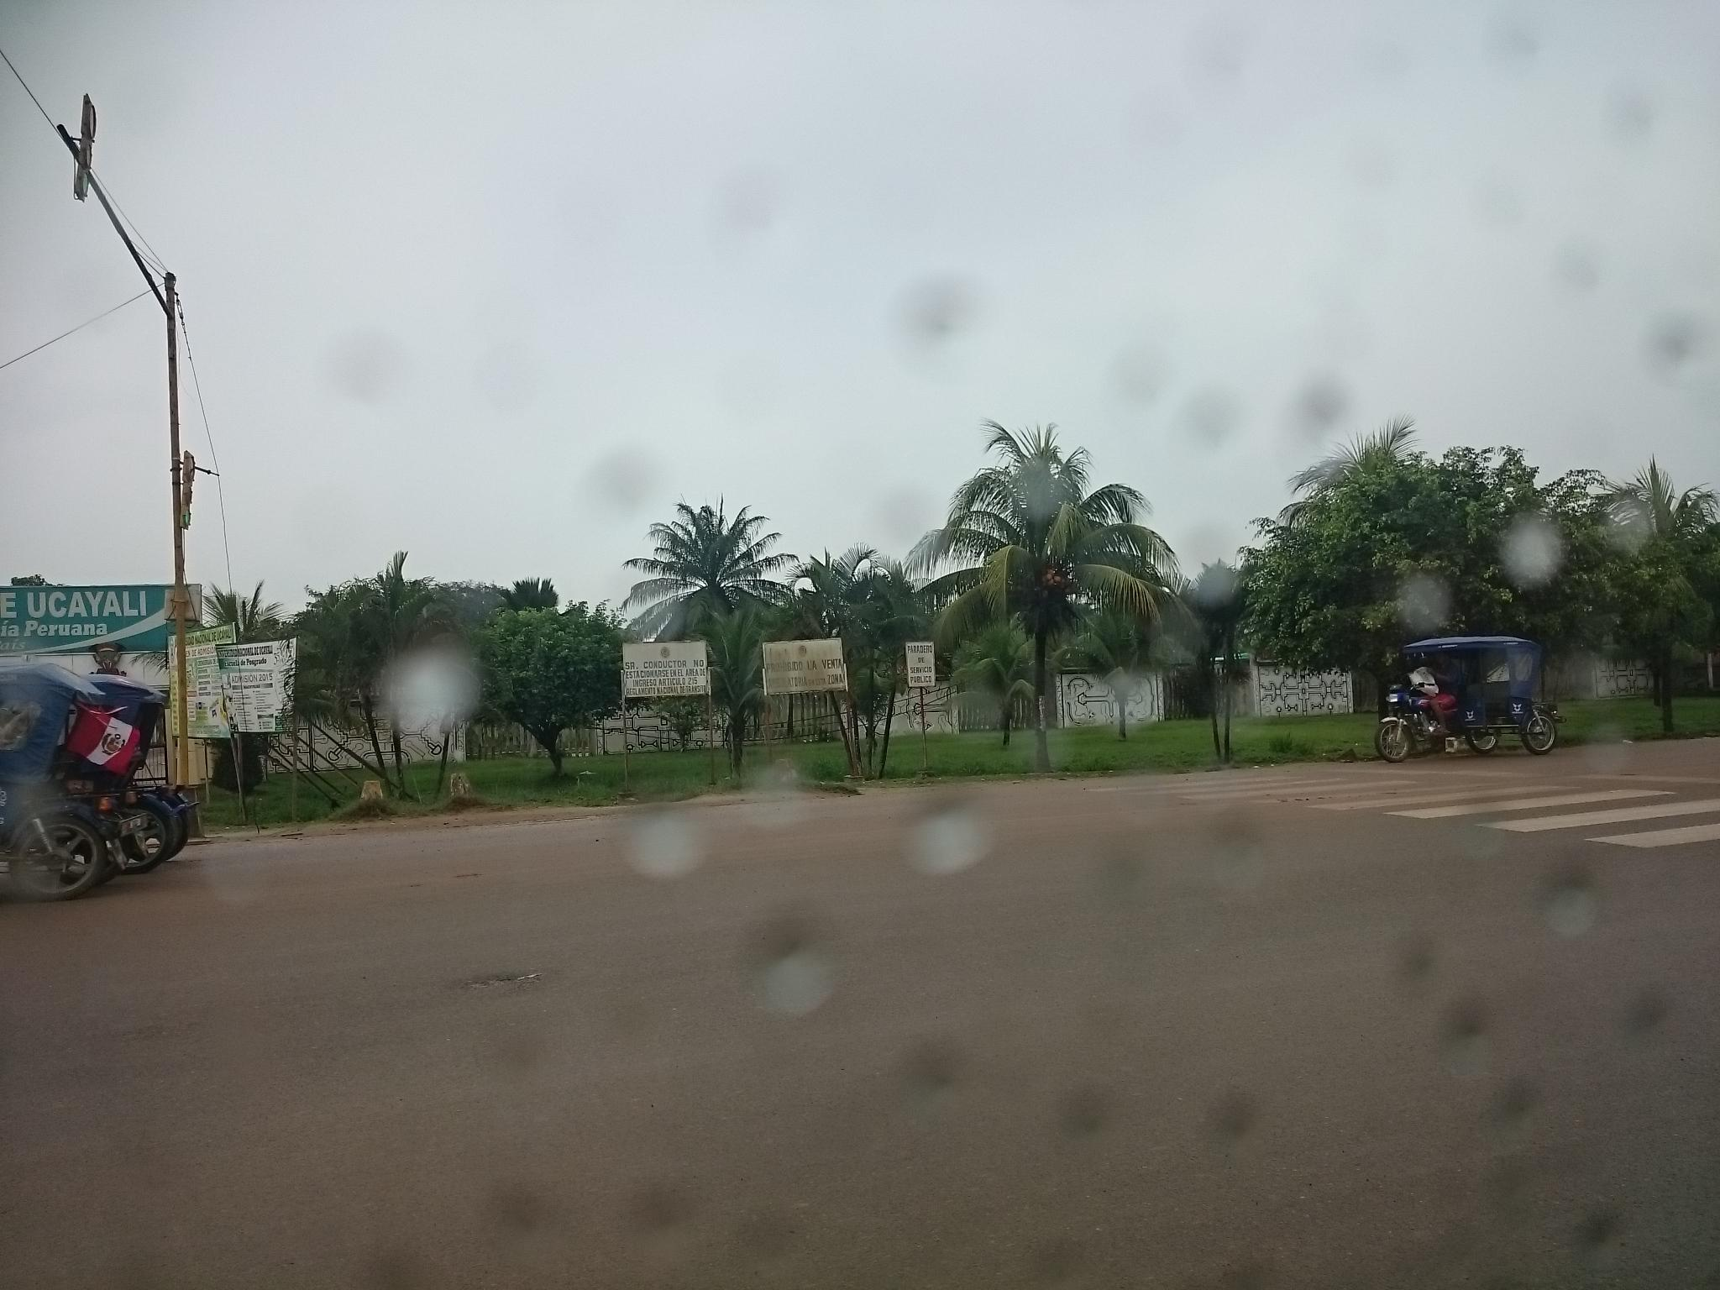
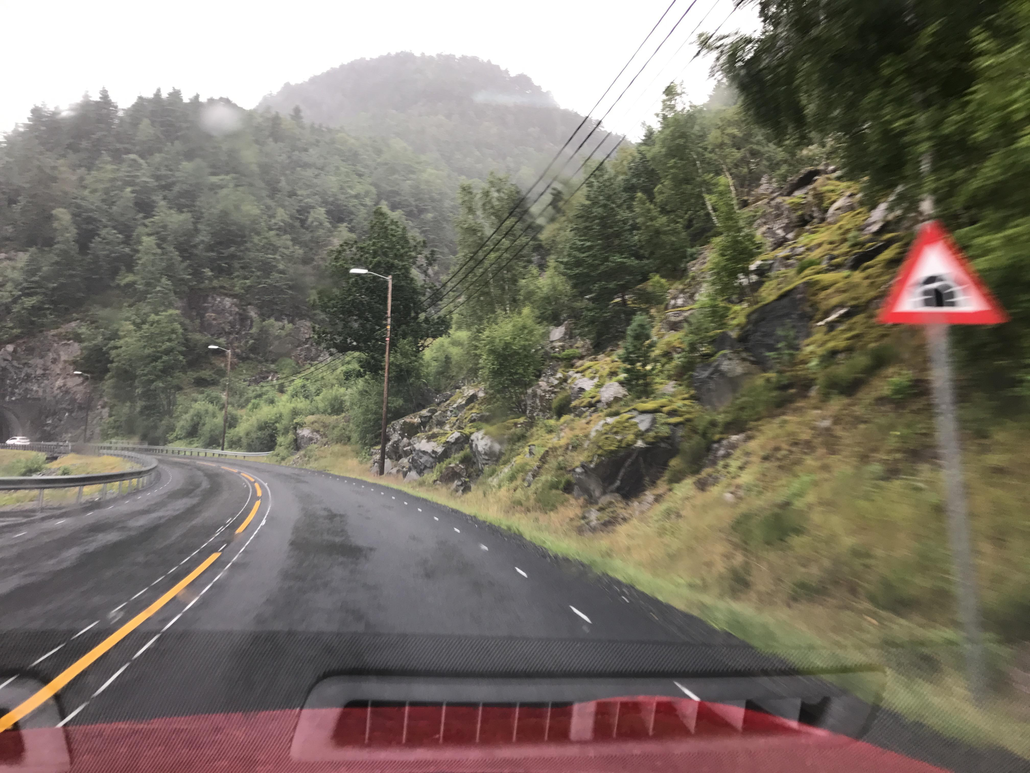
MTSD Mapillary Traffic Sign Dataset
MTSD is a large-scale dataset of street-level imagery with bounding box annotations for detecting and classifying traffic signs
It contains 52,453 images (with 257,543 traffic sign bounding boxes) collected from 60 countries in all regions of the world
The traffic signs in MTSD cover a wide variety of classes, including speed limit signs, stop signs, yield signs, pedestrian crossing signs, and warning signs
MTSD includes bounding box annotations for all traffic signs. This makes it easy to use the dataset for training and evaluating traffic sign detection algorithms
Sun glare
Fog climate
Rain
Motion blur

Slide 10
Modifications to the YOLOv5 model
Feature extraction module
Replace the 32 times down sampling with the 16 times down sampling to reduce the loss of small object information during feature propagation
Clustering algorithm
K-means++ algorithm (optimization algorithm based on K-Means) to re-cluster all labeled object frames in the training dataset
M-YOLOv5
Loss function
Combine both CIoU and NWD (normalized Gaussian Wasserstein distance) to calculate the localization loss
Swin Transformer block (STB)
1x1 convolution instead of 3x3 and adding an STB structure for the feature extraction module

Slide 11
Evaluation Metrics (How efficient is the model?)
mAP - mean average precision
Average precision is calculated for each class, and then the mean of these values is taken to obtain the final mAP score. Higher mAP values indicate better performance.
Detection speed
Time taken for an object detection model to process an input image and produce the detection results (bounding boxes, class predictions, etc.). It is a crucial factor in real-time or interactive applications where the model needs to process images or video frames quickly.
Working area size
Working Area Size generally refers to the resolution or size of the input images or videos that a model can effectively process. It is an important consideration in computer vision tasks, as models need to be able to handle different image sizes and resolutions.
IoU
It is calculated as the ratio of the intersection of the predicted and ground truth regions to the union of these regions. IOU values range from 0 to 1, with 1 indicating a perfect overlap between the predicted and ground truth regions.

Slide 12
References
[1] Álvaro Arcos-García, et al. Evaluation of deep neural networks for traffic sign detection systems. Neurocomputing, Volume 316 (2018) https://doi.org/10.1016/j.neucom.2018.08.009.
[2] Zhou, Weijun, Zhang, Baojun, et al. Detecting Small Chinese Traffic Signs via Improved YOLOv3 Method. Mathematical Problems in Engineering https://doi.org/10.1155/2021/8826593
[3] Wan, J., Ding, W., Zhu, H. et al. An Efficient Small Traffic Sign Detection Method Based on YOLOv3. J Sign Process Syst 93, 899–911 (2021). https://doi.org/10.1007/s11265-020-01614-2
[4] Liu, Z., Li, D., Ge, S.S. et al. Small traffic sign detection from large image. Appl Intell 50, 1–13 (2020). https://doi.org/10.1007/s10489-019-01511-7
[5] Han, C., Gao, G. & Zhang, Y. Real-time small traffic sign detection with revised faster-RCNN. Multimed Tools Appl 78, 13263–13278 (2019). https://doi.org/10.1007/s11042-018-6428-0
[6] Shijin Song, Zhiqiang Que, et al. An efficient convolutional neural network for small traffic sign detection, Journal of Systems Architecture, Volume 97 (2019) https://doi.org/10.1016/j.sysarc.2019.01.012.
[7] Lai, H.; Chen, L.; Liu, W.; Yan, Z.; Ye, S. STC-YOLO: Small Object Detection Network for Traffic Signs in Complex Environments. Sensors 2023, 23, 5307. https://doi.org/10.3390/s23115307
[8] R. Hu, H. Li, D. Huang, X. Xu and K. He, "Traffic Sign Detection Based on Driving Sight Distance in Haze Environment," in IEEE Access, vol. 10, pp. 101124-101136, 2022, doi: 10.1109/ACCESS.2022.3208108.

Slide 13
Thank you

Slide 14
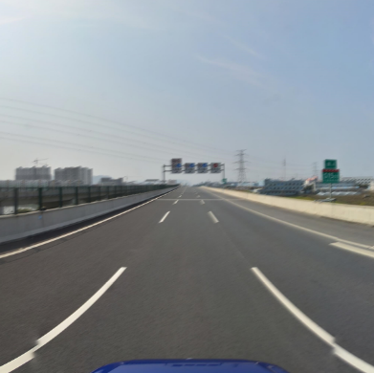
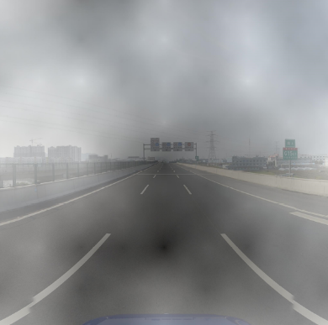
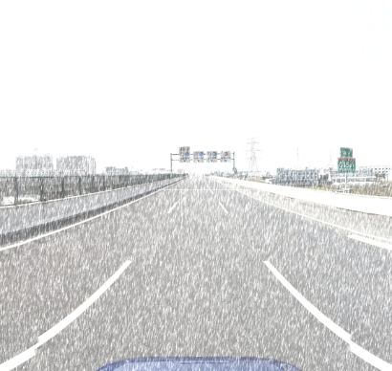
Tsinghua-Tencent 100K dataset
With a substantial collection of 100,000 high-resolution images, the Tsinghua-Tencent 100K dataset provides ample data for training and testing models focused on small traffic sign detection
Most of the traffic signs are quite small, measuring 50 × 50 pixels or less, and they are scattered within a larger 2048 × 2048-pixel image. Each individual sign occupies less than 0.1% of the total image area
captures images from real-world urban environments, offering a realistic representation of the challenges involved in detecting small traffic signs
varying lighting conditions, occlusions, and background clutter, which are typical factors affecting the visibility and recognition of small signs
Normal Image
Fog effect
Snow effect

Slide 15
Evaluation Metrics (How efficient is the model?)
mAP - mean average precision
Accuracy
Working area size
Precision
BFLOPS
Recall
IoU
Detection speed

Slide 16
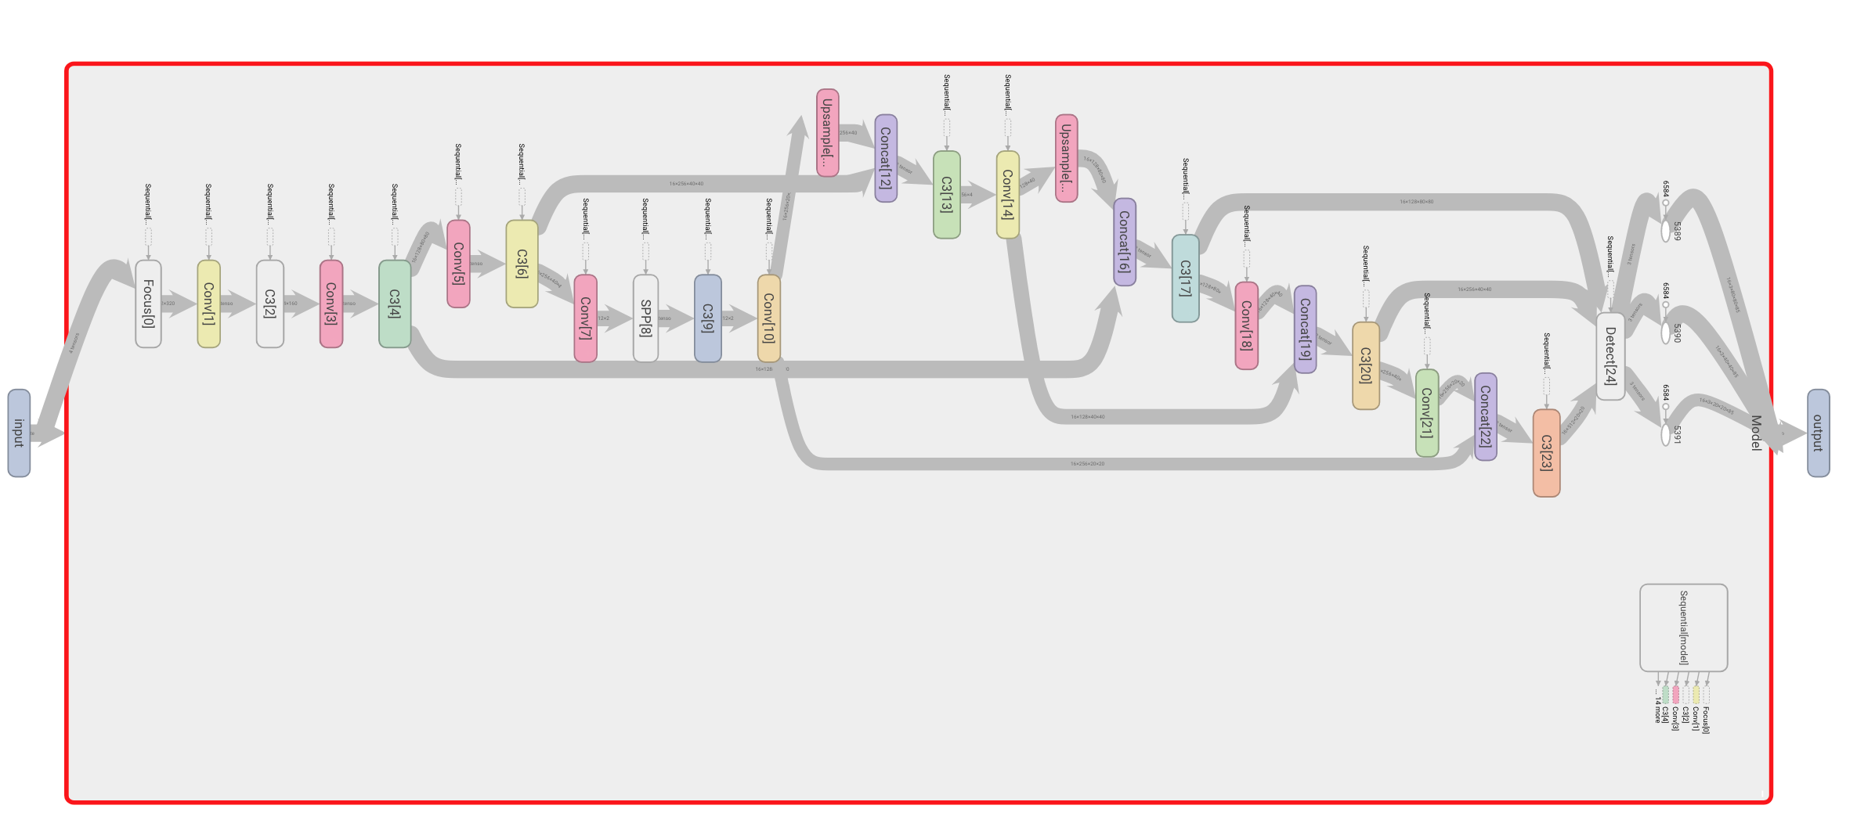
YOLOv5 Architecture

Slide 17
What is the best model for the current research problem?
Based on the literature review, there are certain pros and cons listed down for each of model that help us in choosing the best model for out problem statement.
YOLO
Fast R-CNN
V1: high processing time, more parameters, and increased memory usage
V2: skip connections and multi-scale training, reduced the computational complexity and improved processing speed
V3: feature pyramid networks (FPN), more parameters, increased memory usage and longer training time
V4: CSPDarknet53, PANet, Mish activation and CIOU loss
V5: Optimized model with less parameters, faster training, low memory requirement
improving efficiency
couldn't be accelerated by the GPU
reducing storage requirements
Which way to Chose?
Faster R-CNN
R-CNN
introduced the region proposal network (RPN)
high-level feature map had a lower resolution
couldn’t detect small objects
accurate but slow
required a lot of storage space

